Slide 1

Introduction to APA Style
The following information is
based on:
1). Diana Hacker’s A Writer’s Reference
(and associated web resources);
2). The American Psychological
Association’s Concise Rules of APA Style;
3). The APA’s Publication Manual of the
American Psychological Association, (Fifth
Edition).

Slide 2
Creating the “References” List
In APA style essays, all works cited in in-text citations in the body paragraphs are identified in an alphabetical list of “References.”
This list of “References” is then included as the last page of the document.

Slide 3
The APA System:
In most social science classes, you will be asked to use the APA system for documenting sources. APA recommends in-text citations that refer readers to a list of references:
If the in-text citation looks like this:
Yanovski and Yanovski (2002) reported that “the current state of the treatment for obesity is similar to the state of the treatment of hypertension several decades ago” (p. 600).
The References entry will look like this:
Yanovski, S. Z. & Yanovski, J. A. (2002). Drug therapy: Obesity [Electronic version]. The New England Journal of Medicine, 346, 591-602.

Slide 4
Most References entries
follow this basic pattern:
Article in a Journal:
Author last name, Author first name. (Year). Title of article. Title of Journal, volume number, page number range.
Article in a Book:
Author last name, Author first name. (Year). Title of Book. State of Publication: Name of Publisher.

Slide 5
Article from a Library Database:
Author name/s as above. (Year). Title of article. Title of Journal, vol.#(issue#), page range. Retrieved by Month, Date, Year, from Database Name (Document#).
Holliday, R. E., & Hayes, B. K. (2001). Dissociating automatic and intentional processes in eyewitness memory. Journal of Experimental Child Psychology, 75(1), 1-5. Retrieved February 21, 2001, from Expanded Academic ASAP database (A59317972).

Slide 6
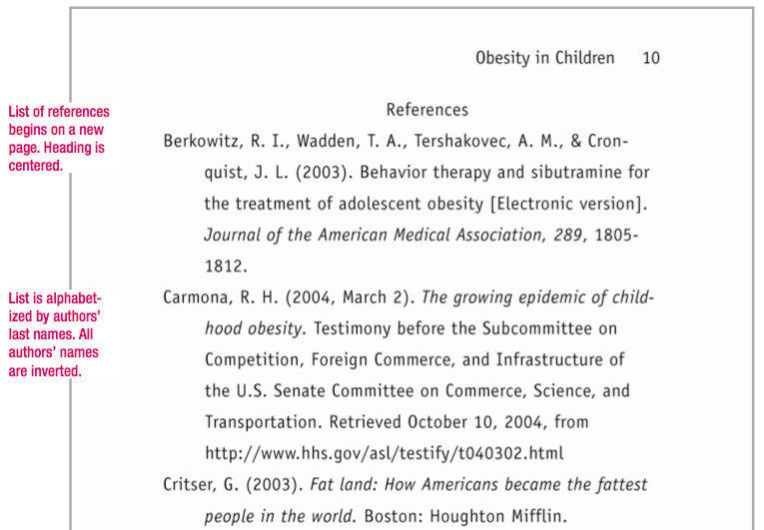

Slide 7
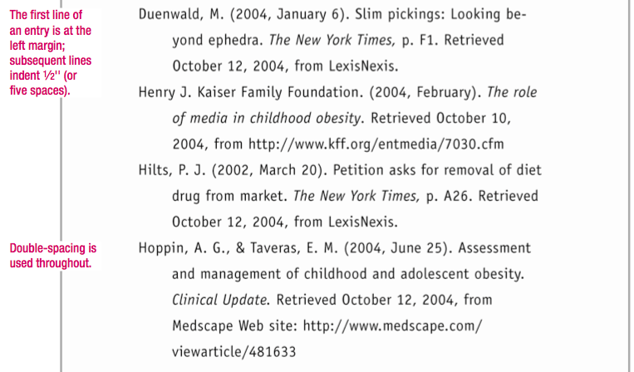

Slide 8
Some Formatting Notes:
Holliday, R. E., & Hayes, B. K. (2001). Dissociating automatic and intentional processes in eyewitness memory. Journal of Experimental Child Psychology, 75(1), 1-5. Retrieved February 21, 2001, from Expanded Academic ASAP database (A59317972).
Article, chapter, Poem, and story titles are written in lower case without italics or quotation marks.
Journal and Book Titles are italicized.
Document # provided only when available.
URL’s aren’t provided for library database sources.

Slide 9
A Quick Note About In-text Citations:
(How Often Do I Cite the Same Source Within a Paragraph?)
Within a paragraph, you don't need to repeat the year or other elements of the in-text citation as long as the reference cannot be confused with other cited sources (or for your own thinking);
If you cite a source in one paragraph and then refer to the same text again in the next, it’s best to re-cite it, so as to avoid confusion;
When in doubt, cite. Better to cite too often than too little (although you are not required to provide in-text citations for A2).

Slide 10
Also, About In-text Citations:
  If you are referring to an idea from another work but NOT directly quoting the material, or making reference to an entire book, article or other work, you only have to make reference to the author and year of publication in your in-text reference.
  If you are paraphrasing an idea from another work, you only have to make reference to the author and year of publication in your in-text reference, but APA guidelines encourage you to also provide the page number (although it is not required.)
  If you are directly quoting from a work, you will need to include the author, year of publication, and the page number for the reference.

Slide 11
Formatting Sources
for which URL’s are Included:
Ashe, D. D., & McCutcheon, L. E. (2001). Shyness, loneliness, and attitude toward celebrities. Current Research in Social Psychology, 6(9). Retrieved July 3, 2001, from http://www.uiowa.edu/~grpproc/crisp/
crisp.6.9.htm
The URL follows the “Retrieved” by date directly after a comma.
Unlike MLA Style, entries with URL’s do not end in periods.

Slide 12
General Guidelines for Listing Authors:
  Alphabetize entries in the list of references by authors last names;
  If a work has no author, alphabetize it by its title;
  The first element of each entry is important because citations in the text of the paper refer to it and readers will be looking for it in the alphabetized list. Make sure the first element of each entry corresponds with your in-text citations;
  The date of publication appears immediately after the first element of the citation.

Slide 13
Examples:
    NAME AND DATE CITED IN TEXT:
      Duncan (2001) has reported that . . .
    BEGINNING OF ENTRY IN THE LIST OF REFERENCES:
      Duncan, B. (2001).

Slide 14
BEGINNING ENTRIES WITH MULTIPLE AUTHORS:
List up to six authors by last names followed by initials.
Use an ampersand (&) between the names of two authors or, if there are more than two authors, before the name of the last author:
  DuNann, D. W., & Koger, S. M. (2004).
  Sloan, F. A., Stout, E. M., Whetten-Goldstein, K., & Liang, L. (2000).
If there are more than six authors, list the first six and “et al.” (meaning “and others”) to indicate that there are others.

Slide 15
BEGINING ENTRY WITH ORGANIZATION AS AUTHOR:
  When the author is an organization, begin with the name of the organization:
    American Psychiatric Association. (2003).
BEGINING ENTRY WHEN AUTHOR IS UNKNOWN:
  Begin the entry with the work’s title.
  Again, titles of books and journals are italicized; Titles of articles are neither italicized nor put in quotation marks:
    Oxford essential world atlas. (2001).
    Omega-3 fatty acids. (2004, November 23).

Slide 16
TWO OR MORE WORKS BY THE SAME AUTHOR:
Use the author’s name for all entries. List the entries by year, the earliest first.
  Schlechty, P. C. (1997).
  Schlechty, P. C. (2001).
TWO OR MORE WORKS BY THE SAME AUTHOR IN THE SAME YEAR:
List the works alphabetically by title. In the parentheses, following the year, add “a,” “b,” c,” etc. Use these same letters when giving the year in the in-text citation.
  Durgin, P. A. (2003a). At-risk behaviors in children.
  Durgin, P. A. (2003b). Treating obesity with psychotherapy.

Slide 17
ARTICLE IN A JOURNAL PAGINATED BY VOLUME:
After the italicized title of the journal, give the volume number (also italicized), followed by the page numbers:
  Morawski, J. (2000). Social psychology a century ago. American Psychologist, 55, 1427-1431.
ARTICLE IN A JOURNAL PAGINATED BY ISSUE:
When each issue of a journal begins with page 1, include the issue number in parentheses after the volume number. Italicize the volume number but not the issue number.
  Smith, S. (2003). Government and nonprofits in the modern age. Society, 40(4), 36-45.

Slide 18
ARTICLE IN A MAGAZINE:
In addition to the year of publication, list the month and, for weekly magazines, the day. If there is a volume number, include it (italicized) after the title.
  Raloff, J. (2001, May 12). Lead therapy won’t help most kids. Science News, 15, 292.
ARTICLE IN A NEWSPAPER:
Begin with the name of the author followed by the exact date of publication. Page numbers are introduced with “p.” (or “pp.”).
  Lohr, S. (2004, December 3). Health care technology is a promise unfinanced. The New York Times, p. C5.

Slide 19
BASIC FORMAT FOR A BOOK:
Begin with the author’s name, followed by the date and the book’s title;
End with the place of publication and the name of the publisher;
Take the information about the book from its title page and copyright page;
If more than one place of publication is given, use only the first; if more than one date is given, use the most recent one.
Example:
  Highmore, B. (2001). Everyday life and cultural theory. New York: Routledge.

Slide 20
BOOK WITH AN EDITOR:
For a book with an editor but no author, begin with the name of the editor (or editors) followed by the abbreviation “Ed.” (or “Eds.”) in parentheses:
  Bronfen, E., & Kavka, M. (Eds.). (2001). Feminist consequences: Theory for a new century. New York: Columbia University Press.
For a book with an author and an editor, begin with the author’s name. Give the editor’s name in parentheses after the title of the book, followed by the abbreviation “Ed.” (or “Eds.”):
  Plath, S. (2000). The unabridged journals (K. V. Kukil, Ed.). New York: Anchor.

Slide 21
ARTICLE OR CHAPTER IN AN EDITED BOOK:
After the author, year of publication, and title of the article or chapter, write “In” and give the editor’s name, followed by “Ed.” in parentheses; the title of the book; and the page numbers of the article or chapter in parentheses. End with the book’s publication information:
  Luban, D. (2000). The ethics of wrongful obedience. In D. L. Rhode (Ed.), Ethics in practice: Lawyers’ roles, responsibilities, and regulation (pp. 94-120). New York: Oxford University Press.

Slide 22
Report From a Private Organization:
If the publisher is the author, give the word “Author” as the publisher. If the report has an author, begin with the author’s name, and the name of the publisher at the end.
Examples: Print Source
American Psychiatric Association. (2000). Practice guidelines for the treatment of patients with eating disorders (2nd ed.). Washington, DC: Author.
Web Only Source
Peer to Peer Counseling Group. (n.d.). Teaching listening skills to large groups. Retrieved July 25,2003, from http://www.peertopeer.org/
listeningskills/00343.html

Slide 23
CITING ELECTRONIC SOURCES
ARTICLE FROM AN ONLINE PERIODICAL
When citing online articles, follow the guidelines for printed articles, giving whatever information is available in the online source.
If the article also appears in a printed journal, a URL is not required; instead, include “Electronic version” in brackets after the title of the article:
  Whitmeyer, J. M. (2000). Power through appointment [Electronic version]. Social Science Research, 29(4), 535-555.
If there is no print version, include the date you accessed the source and the article’s URL:
  Ashe, D. D., & McCutcheon, L. E. (2001). Shyness, loneliness, and attitude toward celebrities. Current Research in Social Psychology, 6(9). Retrieved July 3, 2001, from http://www.uiowa.edu/~grpproc/crisp/
  crisp.6.9.htm

Slide 24
An article from a newspaper’s searchable website:
Give the URL for the site, not for the exact source:
  Cary, B. (2001, June 18). Mentors of the mind. Los Angeles Times. Retrieved July 5, 2001, from http://www.latimes.com

Slide 25
Article from a Database:
To cite an article from a library’s subscription database, include the publication information from the source. End the citation with your date of access, the name of the database, and the document number (if applicable).
Example:
  Holliday, R. E., & Hayes, B. K. (2001). Dissociating automatic and intentional processes in children’s eyewitness memory. Journal of Experimental Child Psychology, 75(1), 1-5. Retrieved February 21, 2001, from Expanded Academic ASAP database (A59317972).

Slide 26
  Notice Placement of punctuation and other key elements of the entry:
  Holliday, R. E., & Hayes, B. K. (2001). Dissociating automatic and intentional processes in children’s eyewitness memory. Journal of Experimental Child Psychology, 75(1), 1-5. Retrieved February 21, 2001, from Expanded Academic ASAP database (A59317972).
Vol. # + Issue # + page #’s
Retrieval Date
Document #

Slide 27
Non-Periodical Web Documents:
To cite a non-periodical Web document, such as a report, list as many of the following elements as are available:
  Author’s name;
  Date of publication (if there is no date, use “n.d.”);
  Title of document (in italics);
  Date you accessed the source;
  A URL that will take readers directly to the source.

Slide 28
Example Non-Periodical Web Source Entries:
In the first model, the source has both an author and a date; in the second, the source lacks a date.
  Cain, A., & Burris, M. (1999, April). Investigation of the use of mobile phones while driving. Retrieved January 15, 2000, from http://www.cutr.eng.usf.edu/
  its/mobile_phone_text.htm
  Archer, Z. (n.d.). Exploring nonverbal communication. Retrieved July 18, 2001, from http://zzyx.ucsc.edu/ ~archer
If a source has no author, begin with the title and follow it with the date in parentheses:
  Exploring nonverbal communication. (1999, April). Retrieved July 18, 2001, from http://zzyx.ucsc.edu/ ~archer

Slide 29
Government Document:
  U.S. Census Bureau. (2000). Statistical abstract of the United States. Washington, DC: U.S. Government Printing Office.
Report from a Private Organization:
If the publisher is the author, give the word “Author” as the publisher. If the report has an author, begin with the author’s name, and name the publisher at the end.
  American Psychiatric Association. (2000). Practice guidelines for the treatment of patients with eating disorders (2nd ed.). Washington, DC: Author.

Slide 30
Television Program:
To cite a television program, list the producer and the date it was aired. Give the title, followed by “Television broadcast” in brackets, the city, and the television network or service:
  Pratt, C. (Executive Producer). (2001, December 2). Face the nation [Television broadcast]. Washington, DC: CBS News.

Slide 31
Email and Personal Interviews:
Email messages and other personal communications are not included in the list of APA style references.
Must, however, use in-text citations within your body paragraphs when information (quotations, paraphrases and summaries) comes from email, letters and face-to-face interviews:
  The pregnancy rate continues to decrease but is still many times higher than in other, comparable countries (E. Robbins, personal communication, January 5, 2006).

Slide 32
Citing Lectures:
There is some contention as to whether or not to cite lectures in the references list, since some people consider them “personal communications.” For our purposes, please cite them as follows:
  Write the speaker’s last name, followed by a comma, followed by their first name;
  Give the title of the presentation in quotes marks;
  Include the name of the institution or conference title, followed by the class title (if applicable);
  Include the location of the lecture, i.e., the city;
  Follow with the day, month (abbreviated) and year (four digits), i.e., 28 Sept. 2005.
    Mesian, Bill. Woman online: fronteering a new feminine power. University of Texas., SOC. 159: Feminist Theory. Austin, Texas. 4 Apr. 2005.

Slide 33
If the lecture material (notes or slides) is available in electronic format, use the format for referencing electronic sources to reference this material even if you read the material first elsewhere (ie: in class). Example:
Smith, P.R. (2003) . New approaches to leadership. Retrieved August 25, 2003 from the University of Auckland, BBIM MGMT 192 Cecil website: http://www.cecil.edu/interface/
cwiframes.asp?UserID=mgmt192

Slide 34
MISCELLANEOUS FORMATTING GUIDELINES:
Begin your list of references on a new page at the end of the paper.
Center the title References about one inch from the top of the page.
Double-space throughout.
APA recommends using a hanging indent: Type the first line of an entry flush left and indent any additional lines one-half inch (or five spaces).
ALPHABETIZING THE LIST
Alphabetize the reference list by the last names of the authors (or editors);
When a work has no author or editor, alphabetize by the first word of the title other than A, An, or The.
If your list includes two or more works by the same author, arrange the entries by year, the earliest first. If your list includes two or more works by the same author in the same year, arrange them alphabetically by title. Add the letters “a,” “b,” and so on within the parentheses after the year.

Slide 35
AUTHORS’ NAMES
Invert all authors’ names and use initials instead of first names. With two or more authors, use an ampersand (&) before the last author’s name. Separate the names with commas. Include names for the first six authors; if there are additional authors, end the list with “et al.” (Latin for
“and others”).
TITLES OF BOOKS AND ARTICLES
Italicize the titles and subtitles of books; capitalize only the first word of the title and subtitle (and all proper nouns). Capitalize names of periodicals as you would capitalize them normally.
ABBREVIATIONS FOR PAGE NUMBERS
Abbreviations for “page” and “pages” (“p.” and “pp.”) are used before page numbers of newspaper articles and articles in edited books but not before page numbers of articles appearing in magazines and scholarly journals.
BREAKING A URL
When a URL must be divided, break it after a slash or before a period. Do not insert a hyphen.Click here for a sample list of references.

Slide 36
For Further Information:
See Diana Hacker’s A Writer’s Reference, pp. 390-417.
  Her online material, which is also linked off of our WRIT 340 main page under “Citing Sources Using APA.”
Purdue’s website on APA is great, too.
Style Wizard can help you with limited citation building and is interactive.

